Slide 1
WebChild: Harvesting and Organizing Commonsense Knowledge from the Web
Date : 2014/09/18
Author : Niket Tandon , Gerard de Melo , Fabian Suchanek , Gerhard Weikum
Source : WSDM’14
Advisor : Jia-ling Koh
Speaker : Shao-Chun Peng

Slide 2
Outline
Introduction
Approach
Experimental
Conclusion

Slide 3
Introduction
What is knowledge bases ?
Web search
text analytics
Recommendations in social media

Slide 4
Introduction
Motivation
Computers completely lack this kind of commonsense knowledge
Round and red
…………

Slide 5
Introduction
How about teach computer?
Round and red
…………

Slide 6
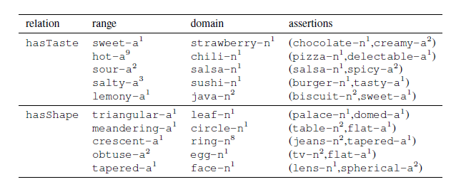
Introduction
Purpose
Automatically extracting and cleaning commonsense properties from the Web

Slide 7
Introduction
salient characteristics and unique qualities
Fine-grained assertions
Disambiguated arguments
Minimal supervision

Slide 8
Outline
Introduction
Approach
Range Population
Domain Population
Computing Assertions
Experimental
Conclusion

Slide 9
Sub task
Range Population
Domain Population
Computing Assertions

Slide 10
Range Population
Candidate Gathering
Graph Construction
EdgeWeighting
Label Propagation (LP)
hasTaste: {delicious, spicy, hot, sweet, etc...}

Slide 11
Range Population
Candidate Gathering
Google N-gram corpus(5-gram)
checking for the presence of the word r , any of its synonyms
40000 adj. for all relation

Slide 12
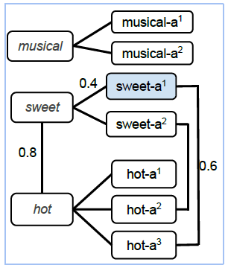
Range Population
Graph Construction
3 kinds of edge
edges among words
edges between two senses u^{-ai} and w^{-aj}
edges between words and senses

Slide 13
Range Population
EdgeWeighting
edges among words
edges between two senses u^{-ai} and w^{-aj}
taxonomic relatedness within WordNet [17]
edges between words and senses
the sense frequencies as a basis for edge weights
Notes:
glosses of their respective hyponyms and hypernyms
有就計算兩者的相關程度
沒有救計算字義和上意詞註釋的相似程度

Slide 14
Range Population
Label Propagation (LP)
Relaton:0.8
Dummy:0.2
Relaton:0.7
Dummy:0.3
Relaton:0.8
Dummy:0.2
A
C
0.8
A
0.8
C
0.2
0.2
B
D
B
D
Relaton:0.1
Dummy:0.9

Slide 15
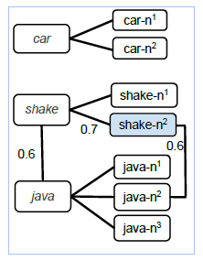
Domain Population
Candidate Gathering*
Graph Construction
EdgeWeighting
Label Propagation (LP)
Beef: hasTaste
sour-a²:the taste experience when vinegar or lemon juice is taken . .
(vinegar, sour-a²) and (lemon juice, sour-a²)
Notes:
gloss for sour-a2 reads “the taste experience when vinegar or lemon juice is taken . . . ”. We generate
two assertions from this: (vinegar, sour-a2) and (lemon juice, sour-a2)

Slide 16
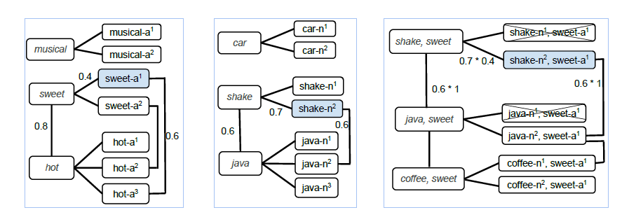
Computing Assertions
Graph Construction*
EdgeWeighting*
Label Propagation (LP)

Slide 17
Outline
Introduction
Approach
Experimental
Conclusion

Slide 18
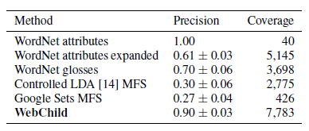
Range Population

Slide 19
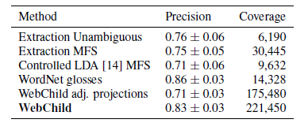
Domain Population

Slide 20
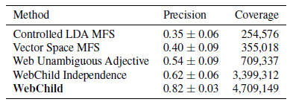
Computing Assertions

Slide 21
Outline
Introduction
Approach
Experimental
Conclusion

